Slide 1





Chapter 6
Mr. Shoaib Raza

Slide 2


Chapter Summary
The Basics of Counting
The Pigeonhole Principle
Permutations and Combinations
Binomial Coefficients and Identities
Generalized Permutations and Combinations

Slide 3

Section 6.1

Slide 4

COMBINATORICS
Combinatorics is the mathematics of counting and arranging objects. Counting of objects with certain properties (enumeration) is required to solve many different types of problem.
Applications, include topics as diverse as codes, circuit design and algorithm complexity [and gambling]

Slide 5

Counting
Enumeration, the counting of objects with certain
properties, is an important part of combinatorics.
We must count objects to solve many different types of problems. For example, counting is used to:
Determine number of ordered or unordered arrangement of objects.
Generate all the arrangements of a specified kind which is important in computer simulations.
Compute probabilities of events.
Analyze the chance of winning games, lotteries etc.
Determine the complexity of algorithms.

Slide 6

Section Summary
The Sum Rule
The Product Rule
The Subtraction Rule
The Division Rule
Examples, Examples, and Examples
Tree Diagrams

Slide 7

Basic Counting Principles: The Sum Rule
The Sum Rule: If a task can be done either in one of n₁ ways or in one of n₂ ways to do the second task, where none of the set of n₁ ways is the same as any of the n₂ ways, then there are n₁ + n₂ ways to do the task.

Slide 8

The Sum Rule in terms of sets.
The sum rule can be phrased in terms of sets.
|A 𝖴 B|= |A| + |B| as long as A and B are disjoint sets.
Or more generally,
|A₁ 𝖴 A₂ 𝖴 ∙∙∙ 𝖴 A_{m} |= |A₁| + |A₂| + ∙∙∙ + |A_{m}|
when A_{i} ∩ A_{j} = ∅ for all i, j.
The case where the sets have elements in common will be discussed when we consider the subtraction rule and taken up fully in Chapter 8.

Slide 9

Basic Counting Principles: The Sum Rule
Example:
Suppose there are 7 different optional courses in Computer Science and 3 different optional courses in Mathematics. How many ways student can choose a course.
Solution: By the sum rule it follows that there are 7 + 3 = 10 choices for a student who wants to take one optional course.

Slide 10

Basic Counting Principles: The Sum Rule
Example: The mathematics department must choose either a student or a faculty member as a representative for a university committee. How many choices are there for this representative if there are 37 members of the mathematics faculty and 83 mathematics majors and no one is both a faculty member and a student.
Solution: By the sum rule it follows that there are
37 + 83 = 120 possible ways to pick a representative.

Slide 11

Basic Counting Principles: The Sum Rule
Example: A student can choose a computer project from one of the three lists. The three lists contain 23, 15 and 19 possible projects, respectively. How many possible projects are there to choose from?
Solution: The student can choose a project from the first list in 23 ways, from the second list in 15 ways, and from the third list in 19 ways. Hence, there are
23 + 15 + 19 = 57 projects to choose from.

Slide 12

Basic Counting Principles: The Product Rule
The Product Rule: A procedure can be broken down into a sequence of two tasks. There are n₁ ways to do the first task and n₂ ways to do the second task. Then there are n₁∙n₂ ways to do the procedure.

Slide 13

Product Rule in Terms of Sets
If A₁, A₂, … , A_{m} are finite sets, then the number of elements in the Cartesian product of these sets is the product of the number of elements of each set.
The task of choosing an element in the Cartesian product A₁ ⨉ A₂ ⨉ ∙∙∙ ⨉ A_{m} is done by choosing an element in A₁, an element in A₂ , …, and an element in A_{m}.
By the product rule, it follows that:
|A₁ ⨉ A₂ ⨉ ∙∙∙ ⨉ A_{m} |= |A₁| ∙ |A₂| ∙ ∙∙∙ ∙ |A_{m}|.

Slide 14

The Product Rule
Example: How many ways a student can choose one optional course each from computer science and mathematics courses if there are 7 different optional courses in Computer Science and 3 different optional courses in Mathematics.
Solution:
A student who wants to take one optional course of each subject, there are 7 × 3 = 21 choices.

Slide 15

The Product Rule
Example: The chairs of an auditorium are to be labeled with two characters, a letter followed by a digit. What is the largest number of chairs that can be labeled differently?
Solution:
The procedure of labeling a chair consists of two events, namely,
Assigning one of the 26 letters: A, B, C, …, Z and Assigning one of the 10 digits: 0, 1, 2, …, 9
By product rule, there are 26 × 10 = 260 different ways that a chair can be labeled by both a letter and a digit.

Slide 16

The Product Rule
Example: Find the number n of ways that an organization consisting of 15 members can elect a president, treasurer, and secretary. (assuming no person is elected to more than one position)
Solution:
The president can be elected in 15 different ways; following this, the treasurer can be elected in 14 different ways; and following this, the secretary can be elected in 13 different ways. Thus, by product rule, there are
n = 15 × 14 × 13 = 2730
different ways in which the organization can elect the officers.

Slide 17

The Product Rule
Example: There are four bus lines between A and B; and three bus lines between B and C.
Find the number of ways a person can travel:
By bus from A to C by way of B;
Round trip by bus from A to C by way of B;
Round trip by bus from A to C by way of B, if the person does not want to use a bus line more than once.

Slide 18


The Product Rule
a) By bus from A to C by way of B; Solution:
There are 4 ways to go from A to B and 3 ways to go from B to C; hence there are 4 × 3 = 12 ways to go from A to C by way of B.

Slide 19


The Product Rule
b) Round trip by bus from A to C by way of B;
Solution:
The person will travel from A to B to C to B to A for the round trip. i.e. (A →B →C →B →A)
The person can travel 4 ways from A to B and 3 way from B to C and back.
Thus there are 4 ×3 ×3 × 4 = 144 ways to travel the round trip.

Slide 20


The Product Rule
c) Round trip by bus from A to C by way of B, if the person does not want to use a bus line more than once.
Solution:
The person can travel 4 ways from A to B and 3 ways from B to C, but only 2 ways from C to B and 3 ways from B to A, since bus line cannot be used more than once. Hence there are
4 ×3 ×2 × 3 = 72 ways
to travel the round trip without using a bus line more than once.

Slide 21

The Product Rule
Example: A bit string is a sequence of 0’s and 1’s.How many bit string are there of length 4?
Solution:
Each bit (binary digit) is either 0 or 1.
Hence, there are 2 ways to choose each bit. Since we have to choose four bits therefore,
the product rule shows, there are a total of different bit strings of length four.

Slide 22


The Product Rule
Example: How many bit strings of length 8: (i ) begin with a 1?
(ii) begin and end with a 1?
Solution:
(i) If the first bit (left most bit) is a 1, then it can be filled in only one way. Each of the remaining seven positions in the bit string can be filled in 2 ways (i.e., either by 0 or 1). Hence, there are
different bit strings of length 8 that begin with a 1.

Slide 23


The Product Rule
(ii) begin and end with a 1?
Solution:
If the first and last bit in an 8 bit string is a 1, then only the intermediate six bits can be filled in 2 ways, i.e. by a 0 or 1.
Hence there are
different bit strings of length 8 that begin and end with a 1.

Slide 24

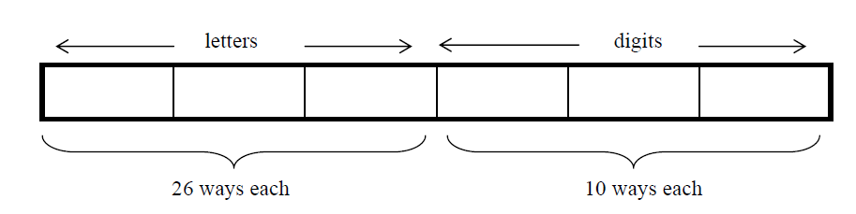
The Product Rule
Example: Suppose that an automobile license plate has three letters followed by three digits.
(a) How many different license plates are possible?
Solution:
Each of the three letters can be written in 26 different ways, and each of the three digits can be written in 10 different ways.
Hence, by the product rule, there is a total of
26 × 26 × 26 × 10 × 10 × 10 = 17,576,000
different License plates possible.

Slide 25

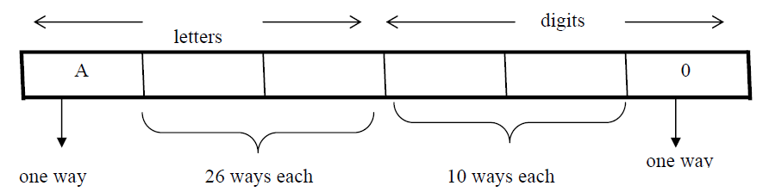
The Product Rule
(b) How many license plates could begin with A and end on 0?
Solution:
The first and last place can be filled in one way only, while each of second and third place can be filled in 26 ways and each of fourth and fifth place can be filled in 10 ways.
Number of license plates that begin with A and end in 0 are
1 × 26 × 26 × 10 × 10 × 1 = 67600

Slide 26

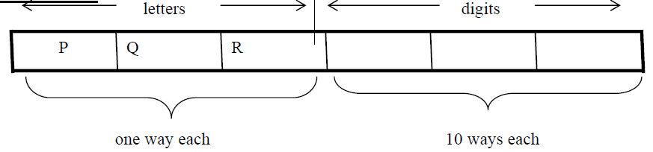
The Product Rule
(c) How many license plates begin with PQR.
Solution:
Number of license plates that begin with PQR are
1 × 1 × 1 × 10 × 10 × 10 = 1000 ways.

Slide 27

The Product Rule
(d) How many license plates are possible in which all the letters and digits are distinct?
Solution:
The first letter place can be filled in 26 ways. Since, the second letter place should contain a different letter than the first, so it can be filled in 25 ways. Similarly, the third letter place can be filled in 24 ways. And the digits can be respectively filled in 10, 9, and 8 ways.
Hence;
number of license plates in which all the letters and digits are distinct are
26 × 25 × 24 × 10 × 9 × 8 = 11, 232, 000

Slide 28

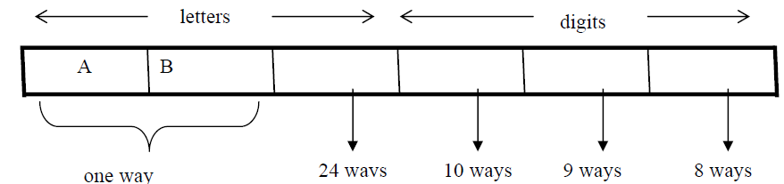
The Product Rule
(e) How many license plates could begin with AB and
three letters and digits distinct.
Solution:
have all
The first two letters places are fixed (to be filled with A and B), so there is only one way to fill them. The third letter place should contain a letter different from A & B, so there
are 24 ways to fill it.
The three digit positions can be filled in 10 and 8 ways to have distinct digits. Hence, desired number of license plates are
1 × 1 × 24 × 10 × 9 × 8 = 17280

Slide 29

Telephone Numbering Plan
Example: The North American numbering plan (NANP) specifies that a telephone number consists of 10 digits, consisting of a three-digit area code, a three-digit office code, and a four-digit station code. There are some restrictions on the digits.
Let X denote a digit from 0 through 9.
Let N denote a digit from 2 through 9.
Let Y denote a digit that is 0 or 1.
In the old plan (in use in the 1960s) the format was NYX-NNX-XXXX.
In the new plan, the format is NXX-NXX-XXXX.
How many different telephone numbers are possible under the old plan and the new plan?
Solution: Use the Product Rule.
There are 8 ∙2 ∙10 = 160 area codes with the format NYX.
There are 8 ∙10 ∙10 = 800 area codes with the format NXX.
There are 8 ∙8 ∙10 = 640 office codes with the format NNX.
There are 10 ∙10 ∙10 ∙10 = 10,000 station codes with the format XXXX. Number of old plan telephone numbers: 160 ∙640 ∙10,000 = 1,024,000,000. Number of new plan telephone numbers: 800 ∙800 ∙10,000 = 6,400,000,000.

Slide 30

NUMBER OF ITERATIONS OF A NESTED LOOP
Example: Determine how many times the inner loop will be
iterated
when the following algorithm is implemented and run For i: = 1 to 4
For j : = 1 to 3
[Statement in body of inner loop. None contain branching statements that lead out of the inner loop.]
next j
next i
Solution:
The outer loop is iterated four times, and during each iteration of
the outer loop, there are three iterations of the inner loop.
Hence, by product rules the total number of iterations of inner loop is 4·3=12

Slide 31

Example: Determine how many times the inner loop will be iterated when the following algorithm is implemented and run.
for i = 5 to 50
for j: = 10 to 20
[Statement in body of inner loop. None contain branching statements that lead out of the inner loop.]
next j next i
Solution:
The outer loop is iterated 50 - 5 + 1 = 46 times and during each iteration of the outer loop there are 20 - 10 + 1 = 11 iterations of the inner loop. Hence by product rule, the total number of iterations of the inner loop is 46×11 = 506.

Slide 32

Example: Determine how many times the inner loop will be iterated when the following algorithm is implemented and run.
for i: = 1 to 4
for j: = 1 to i
[Statements in body of inner loop. None contain branching statements that lead outside the loop.]
next j next i
Solution:
The outer loop is iterated 4 times, but during each iteration of the outer loop, the inner loop iterates different number of times.
For first iteration of outer loop, inner loop iterates 1 times. For second iteration of outer loop, inner loop iterates 2 times.
For third iteration of outer loop, inner loop iterates 3 times.
For fourth iteration of outer loop, inner loop iterates 4 times. Hence, total number of iterations of inner loop = 1 + 2 + 3 + 4 = 10.

Slide 33

Combining the Sum and Product Rule
Example: Suppose statement labels in a programming language can be either a single letter or a letter followed by a digit. Find the number of possible labels.
Solution:
First consider variable names one character in length. Since such names consist of a single letter, there are 26 variable names of length 1.
Next, consider variable names two characters in length. Since the first character is a letter, there are 26 ways to choose it. The second character is a digit, there are 10 ways to choose it. Hence, to construct variable name of two characters in length, there are 26×10 = 260 ways.
Finally, by sum rule, there are 26 + 260 = 286 possible variable names in the programming language.

Slide 34

Combining the Sum and Product Rule
Example: A computer access code word consists of from one to three letters of English alphabets with repetitions allowed. How many different code words are possible.
Solution:
Number of code words of length 1 = 26¹ Number of code words of length 2 = 26² Number of code words of length 3 = 26³ Hence, the total number of code words =
26¹+ 26² + 26³= 18,278

Slide 35

Counting Passwords
Combining the sum and product rule allows us to solve more complex problems.
Example: Each user on a computer system has a password, which is six to eight characters long, where each character is an uppercase letter or a digit. Each password must contain at least one digit. How many possible passwords are there?
Solution: Let P be the total number of passwords, and let P₆, P₇, and P₈
be the passwords of length 6, 7, and 8.
By the sum rule P = P₆ + P₇ +P₈.
Finding P₆ directly is difficult. To find P₆ it is easier to find the number of strings of uppercase letters and digits that are six characters long, including those with no digits, and subtract from this the number of strings with no digits. By the product rule, the number of strings of six characters is 36⁶ ,and the number of strings with no digits is 26⁶

Slide 36

Counting Passwords(Continued)
To find each of P6, P7, and P8 , we find the number of passwords of the specified length composed of letters and digits and subtract the number composed only of letters. We find that:
P₆ = 36⁶ − 26⁶ = 2,176,782,336 − 308,915,776 =1,867,866,560.
P₇ = 36⁷ − 26⁷ = 78,364,164,096 − 8,031,810,176 = 70,332,353,920.
P₈ = 36⁸ − 26⁸ = 2,821,109,907,456 − 208,827,064,576 =2,612,282,842,880.
Consequently, P = P₆ + P₇ + P₈ = 2,684,483,063,360.

Slide 37

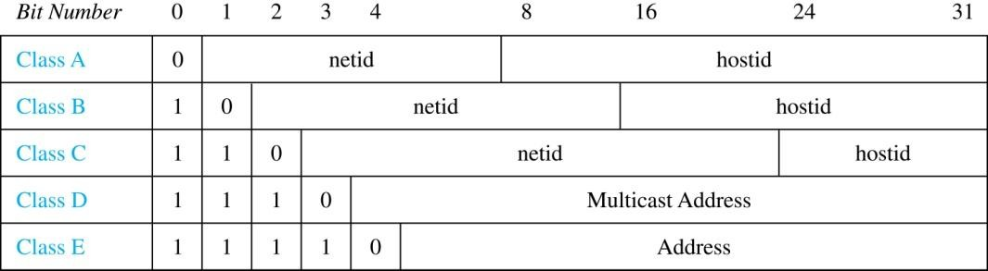
Internet Addresses
Version 4 of the Internet Protocol (IPv4) uses 32 bits.
Class A Addresses: used for the largest networks, a 0,followed by a 7-bit netid and a 24-bit hostid.
Class B Addresses: used for the medium-sized networks, a
10,followed by a 14-bit netid and a 16-bit hostid.
Class C Addresses: used for the smallest networks, a
110,followed by a 21-bit netid and a 8-bit hostid.
Neither Class D nor Class E addresses are assigned as the address of a computer on the internet. Only Classes A, B, and C are available.
1111111 is not available as the netid of a Class A network.
Hostids consisting of all 0s and all 1s are not available in any
network.

Slide 38

Counting Internet Addresses
Example: How many different IPv4 addresses are available for
computers on the internet?
Solution: Use both the sum and the product rule. Let x be the number of available addresses, and let x_{A}, x_{B}, and x_{C} denote the number of addresses for the respective classes.
To find, x_{A}: 2⁷ − 1 = 127 netids. 2²⁴ − 2 = 16,777,214 hostids.
x_{A} = 127∙ 16,777,214 = 2,130,706,178.
To find, x_{B}: 2¹⁴ = 16,384 netids. 2¹⁶ − 2 = 16,534 hostids.
x_{B} = 16,384 ∙ 16, 534 = 1,073,709,056.
To find, x_{C}: 2²¹ = 2,097,152 netids. 2⁸ − 2 = 254 hostids.
x_{C} = 2,097,152 ∙ 254 = 532,676,608.
Hence, the total number of available IPv4 addresses is
x = x_{A} + x_{B} + x_{C}
= 2,130,706,178 + 1,073,709,056 + 532,676,608
= 3, 737,091,842.
Not Enough Today !!
The newer IPv6 protocol solves the problem
of too few addresses.

Slide 39

Basic Counting Principles: Subtraction Rule
Subtraction Rule: If a task can be done either in one of n₁ ways or in one of n₂ ways, then the total number of ways to do the task is n₁ + n₂ minus the number of ways to do the task that are common to the two different ways.
Also known as, the principle of inclusion-exclusion:

Slide 40

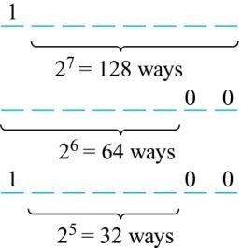
Counting Bit Strings
Example: How many bit strings of length eight start either with a 1 bit or end with the two bits 00?
Solution: Use the subtraction rule.
Number of bit strings of length eight that start with a 1 bit: 2⁷ = 128
Number of bit strings of length eight that end with bits 00: 2⁶ = 64
Number of bit strings of length eight
that start with a 1 bit and end with bits 00 : 2⁵ = 32
Hence, the number is 128 + 64 − 32 = 160.

